Slide 1

Chapter 5 Data and Processing Modeling
Mina Gabriel

Slide 2
Objectives
• Explain the purpose of data-flow diagrams.
• Describe the meaning of the symbols used in data-flow diagrams.
• Construct simple data-flow diagrams from a textual description.
• Construct a levelled set of data-flow diagrams.

Slide 3
What are data-flow diagrams?
Data-flow diagrams provide a graphical representation of the system that aims to be accessible to computer specialist and non-specialist users alike.
The models enable software engineers, customers and users to work together effectively during the analysis and specification of requirements.
Although this means that our customers are required to understand the modeling techniques and constructs, in data-flow modeling only a limited set of constructs are used, and the rules applied are designed to be simple and easy to follow.

Slide 4
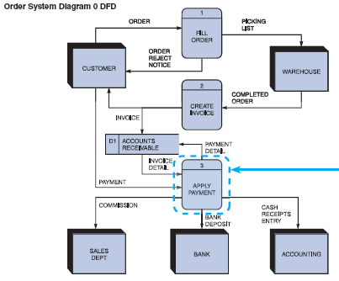
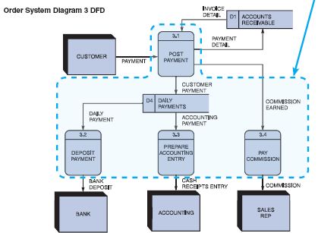
An example data-flow diagram

Slide 5
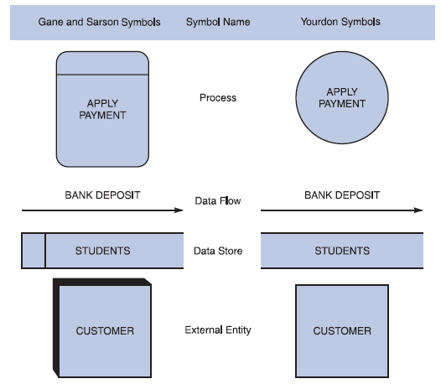
DFD notation consists of only four main symbols:
DFD Symbols
Four basic symbols
Gane & Sarson used in text
Yourdon also popular

Slide 6
DFD notation consists of only four main symbols:
1. Processes — the activities carried out by the system which use and transform information. Processes are notated as rectangles with three parts, such as “Order Supplies” and “Make Payments.
2. Data-flows — the data inputs to and outputs from to these activities. Data-flows are notated as named arrows, such as “Delivery” and “Supply Order”.
3. External entities — the sources from which information flows into the system and the recipients of information leaving the system. External entities are notated as ovals, such as “Supplier”.
4. Data stores — where information is stored within the system. Data stores are notated as rectangles with two parts, such as “Supplier Details” and “Orders”.

Slide 7
The benefits of data-flow diagrams
The system scope and boundaries are clearly indicated on the diagrams.
The technique of decomposition of high level data-flow diagrams to a set of more detailed diagrams, provides an overall view of the complete system, as well as a more detailed breakdown and description of individual activities, where this is appropriate, for clarification and understanding.

Slide 8
Case study Video-Rental LTD case study :
Video-Rental LTD is a small video rental store. The store lends videos to customers for a fee, and purchases its videos from a local supplier.
A customer wishing to borrow a video provides the empty box of the video they desire, their membership card, and payment – payment is always with the credit card used to open the customer account.
The customer then returns the video to the store after watching it.
If a loaned video is overdue by a day the customer's credit card is charged, and a reminder letter is sent to them. Each day after that a further card is made, and each week a reminder letter is sent.
This continues until either the customer returns the video, or the charges are equal to the cost of replacing the video. New customers fill out a form with their personal details and credit card details, and the counter staff give the new customer a membership card. Each new customer's form is added to the customer file.
The local video supplier sends a list of available titles to Video-Rental LTD, who decide whether to send them an order and payment. If an order is sent then the supplier sends the requested videos to the store. For each new video a new stock form is completed and placed in the stock file.

Slide 9
The different kinds (and levels) of data-flow diagrams
Although all data-flow diagrams are composed of the same types of symbols, and the validation rules are the same for all DFDs, there are three main types of data-flow diagram:
Context diagrams — context diagram DFDs are diagrams that present an overview of the system and its interaction with the rest of the “world”.
Level 1 data-flow diagrams — Level 1 DFDs present a more detailed view of the system than context diagrams, by showing the main sub-processes and stores of data that make up the system as a whole.
Level 2 (and lower) data-flow diagrams — a major advantage of the data-flow modelling technique is that, through a technique called “levelling”, the detailed complexity of real world systems can be managed and modeled in a hierarchy of abstractions.

Slide 10
Elements of data-flow diagrams
Four basic elements are used to construct data-flow diagrams:
processes
data-flows
data stores
external entities

Slide 11
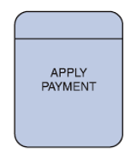
Processes
Purpose : Receives input data and produces output that has different content, form, or both.
Notation: rectangle with round corners, the top part contains the process number.

Slide 12
Processes
Rules
Process Symbol
Must have at least one input and at least one output
Contains business logic that transforms the data
Process name identifies its function (verb)
Process number does not signify precedence
Examples: “print bill” or “add customer”

Slide 13
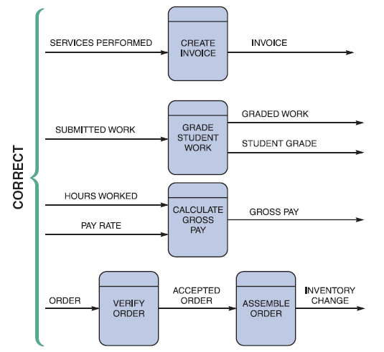
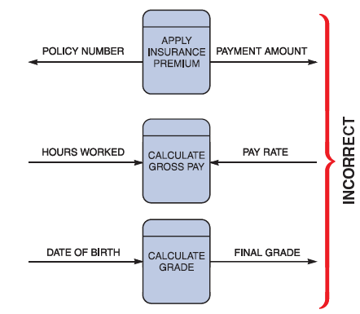
Processes

Slide 14
Data Flow Symbol
Is a path for data to move from one part of the information system to the other.
The symbol for a data flow is a line with a single or double arrowhead

Slide 15
Data Flow Symbol

Slide 16

External entities
Shows how the system interfaces with the outside world
A DFD shows only external entities that provide data to the system or receive output from the system
DFD entities also are called terminators because they are data origins or final destinations
Each entity must be connected to a process by a data flow

Slide 17
External entities
Each external entity must communicate with the system in some way, thus there is always a dataflow between an external entity and a process within the system.
External entities may provide and receive data from a number of processes. It may be appropriate, for the sake of clarity and to avoid crisscrossing of data flows, to depict the same external entity at a number of points on the diagram. Where this is the case, a line is drawn across the left corner of the ellipse, for each occurrence of the external entity on the diagram. Customer is duplicated in this way in our example.

Slide 18
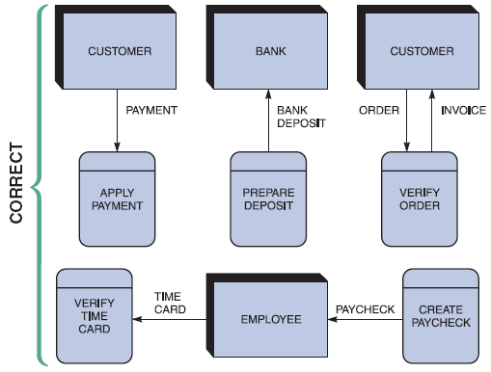
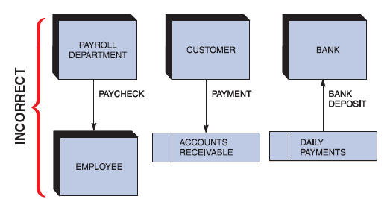
External entities
FIGURE 5-10 Examples of incorrect uses of external entities. An external entity must be connected by a data flow to a process, and not directly to a data store or to another external entity

Slide 19

Data Stores
Represent data that the system stores
A DFD does not show the detailed contents of a data store — the specific structure and data elements are defined in the data dictionary
A data store must be connected to a process with a data flow

Slide 20
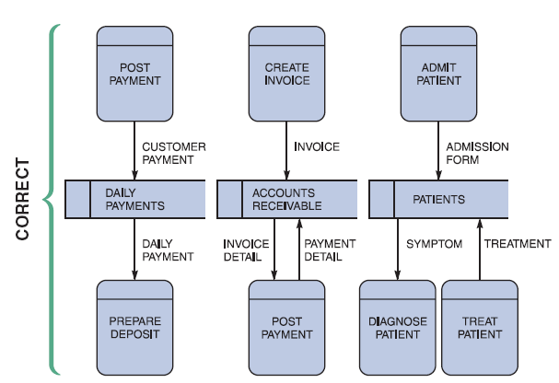
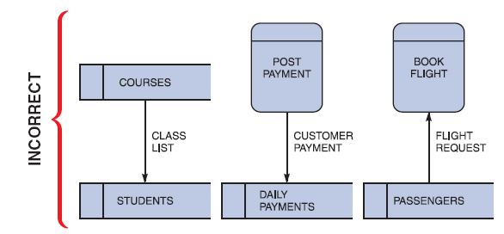
Data Stores
FIGURE 5-8 Examples of incorrect uses of data store symbols: Two data stores cannot be connected by a data flow without an intervening process, and each data store should have an outgoing and incoming data flow

Slide 21
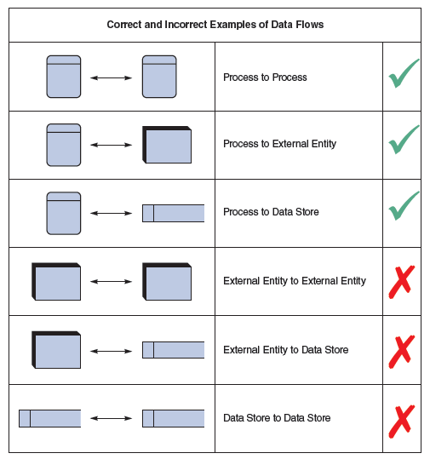
Creating a Set of DFDs

Slide 22
Context diagrams
What is a context diagram?
A context diagram, sometimes called a level 0 data-flow diagram, is drawn in order to define and clarify the boundaries of the software system. It identifies the flows of information between the system and external entities. The entire software system is shown as a single process.

Slide 23
Constructing a context diagram
In order to produce the context diagram and agree on system scope, the following must be identified:
external entities
data-flows

Slide 24
You may find the following steps useful:
1. Identify data-flows by listing the major documents and information flows associated with the system, including forms, documents, reference material, and other structured and unstructured information (emails, telephone conversations, information from external systems, etc.).
2. Identify external entities by identifying sources and recipients of the data-flows, which lie outside of the system under investigation. The actors and any use case models you have created may often be external entities.
3. Draw and label a process box representing the entire system.
4. Draw and label the external entities around the outside of the process box.
5. Add the data-flows between the external entities and the system box. Where documents and other packets of information flow entirely within the system, these should be ignored from the point of view of the context diagram – at this stage they are hidden within the process box.

Slide 25
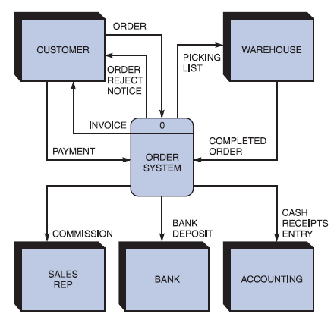
Context Diagram “process zero”

Slide 26
Exercise
Draw a context diagram for Video-Rental LTD

Slide 27
Level 1 data-flow diagrams
What is a level 1 DFD?
As described previously, context diagrams (level 0 DFDs) are diagrams where the whole system is represented as a single process. A level 1 DFD notates each of the main sub-processes that together form the complete system. We can think of a level 1 DFD as an “exploded view” of the context diagram.

Slide 28
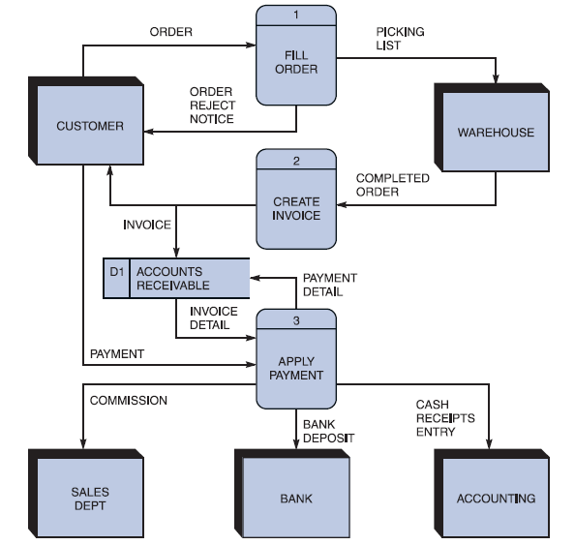
Level 1 data-flow diagrams
We can see that on this level 1 DFD there are a number of data stores, and data-flows between processes
and the data stores

Slide 29
Constructing level 1 DFDs
1. Identify processes. Each data-flow into the system must be received by a process. For each dataflow into the system examine the documentation about the system and talk to the users to establish a plausible process of the system that receives the data-flow. Each process must have at least one output data-flow. Each output data-flow of the system must have been sent by a process; identify the processes that sends each system output.
2. Draw the data-flows between the external entities and processes.
3. Identify data stores by establishing where documents / data needs to be held within the system. Add the data stores to the diagram, labelling them with their local name or description.
4. Add data-flows flowing between processes and data stores within the system. Each data store must have at least one input data-flow and one output data-flow (otherwise data may be stored, and never used, or a store of data must have come from nowhere). Ensure every data store has input and output data-flows to system processes. Most processes are normally associated with at least one data store.
5. Check diagram. Each process should have an input and an output. Each data store should have an input and an output. Check the system details so see if any process appears to be happening for no reason (i.e., some “trigger” data-flow is missing, that would make the process happen).

Slide 30
Exercise
Construct level 1 DFDs “Diagram zero” for Video-Rental LTD

Slide 31
Decomposing diagrams into level 2 and lower hierarchical levels
We have already seen how a level 0 context diagram can be decomposed (exploded) into a level 1 DFD. In DFD modeling terms we talk of the context diagram as the “parent” and the level 1 diagram as the “child”
This same process can be applied to each process appearing within a level 1 DFD. A DFD that represents a decomposed level 1 DFD process is called a level 2 DFD. There can be a level 2 DFD for each process that appears in the level 1 DFD.

Slide 32
FIGURE 5-19 The order system diagram 0 is shown at the top of the figure, and exploded diagram 3 DFD (for the APPLY PAYMENT process) is shown at the bottom. The two DFDs are balanced because the child diagram at the bottom has the same input and output flows as the parent process 3 shown at the top

Slide 33
Exercise
Select one of Video-Rental LTD level 1 processes and dicompose a level 2 diagram for this process

Slide 34
Leveling and Balancing
Leveling uses a series of increasingly detailed DFDs to describe an information system.
Balancing ensures that the input and output data flows of the parent DFD are maintained on the child DFD, if a second level diagram expands a first level process then all the inputs to the process must be inputs to the second level diagram, and all the outputs from the process must be outputs on the second level diagram. Moreover, there must be no other inputs and outputs.

